Slide 1

Garbage Collection
.NET vs Java

Slide 2
Next
26/9 : RXJS (FTrack, Hands-On)
6/10 : Docker & Docker-Compose ;) (FunTrack, Hands-On)
x/11 : Architecture/Frontend Track? UnitTesting Hands-On?

Slide 3
SESSION BADGES
Indication Content & Time & Difficulty Level
Theoretical
Hands-On
Code-Show
x… with exercises at the end
Session Type
TechSession
ATrack: Architecture Track
FTrack: Frontend Track
Notes:
All feedback is welcome!
Theoretical: GarbageCollection, ArchitectureTrack KickOff
Hands-On: RXJS
Code-Show: Vue
Theoretical with exercises at the end: UnitTesting, React

Slide 4

Garbage Collection
1h
.NET vs Java
Theoretical
Introduction
Notes:
All feedback is welcome!

Slide 5
MENU
What
Why (Not)
Strategies
Java vs .NET
Winner
Notes:
Winner:
And then we force all our consultants to change primary language to the winning language.

Slide 6

Inspirational Quote

Slide 7
What
Automatic Memory Management
Doesn’t handle Network, Files, Db, …
Generally Undeterministic
Around since 1959 (Lisp)
Focus on Syntactic Garbage
Notes:
Invented by John McCarthy (coined “AI”, Lisp, ALGOL)
Other not handled: Windows (UI element), Device descriptors, …

Slide 8
What
Syntactic Garbage: No longer reachable
var x = new Foo();
x = new Bar(); // Foo is syntactic garbage
Semantic Garbage: Cannot be used anymore
var x = new Foo();
if (x.valid) { // x is semantic garbage, if x.valid is false
x.bar();
}
Notes:
Syntactic Garbage:
→ Main focus for GCs
Semantic Garbage:
→ Active research area

Slide 9
What: Types
C & C++: malloc/new & free
Java, .NET, Go & scripting & functional: automatic
D: Garbage collected but can manually cleanup
Ada & C++/CLI : Heaps for automatic & manual
Library: Boehm garbage collector for C/C++, Mono, …
ARC: Automatic Reference Counting
Notes:
Without: Delphi (limited Reference Counting)
Manual & Automatic GC:
Ada (Pascal family, after Ada Lovelance)
Modula-3 (influenced the design of Java, NET & Python)
C++/CLI (Common Language Infrastructure)
Scripting language without GC: Dyon, Perl 5
Functional with: Haskell, ML, APL, Lisp
Boehm:
Mark & Sweep, Generational, Incremental, Finalizers
ARC: after the fact GC (litter collection)
Some work without recompilation

Slide 10
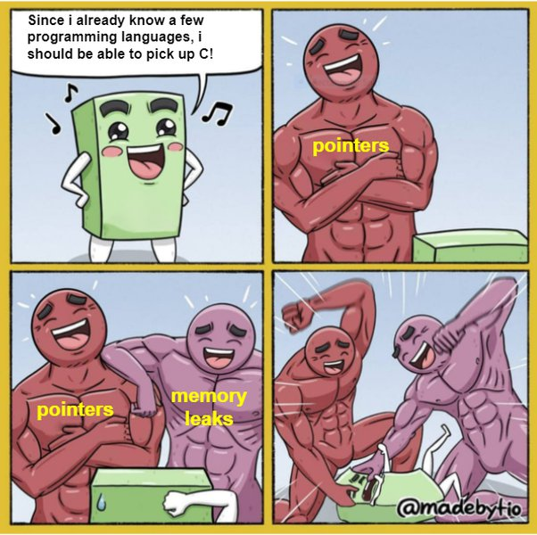
WHY
Memory Management
is
HARD
Notes:
You want to focus on delivering business value
Not chasing & fixing memory bugs

Slide 11
WHY
70% of all vulnerabilities fixed with a security update are memory safety issues
In all Microsoft products
In Google Chrome
Notes:
Link: https://www.zdnet.com/article/microsoft-70-percent-of-all-security-bugs-are-memory-safety-issues/
Disclosed by a Microsoft security engineer on a conference.
The same metric applies to Google Chrome: https://www.zdnet.com/article/chrome-70-of-all-security-bugs-are-memory-safety-issues/
Google Chrome: Half of the 70% are use-after-free vulnerabilities

Slide 12
WHY
Memory Safety Issues
Use after free
Buffer overflow
Race condition
Null pointer
…
Notes:
GC won’t safe you from all of them!!
Use after free: allocate a big chunk of memory, free it but keep reading from it, hoping for something useful
Buffer overflow: keep writing until you arrive at a point where you want your own instructions or data to be present
Race condition: Two processes/threads reading/writing the same block
Other:
stack exhaustion
heap exhaustion/corruption
double free
page fault

Slide 13
WHY
What’s the worst that can happen?
char *p = (char*)malloc(4 * sizeof(char));
strcpy(p, "moreThan3");
free(p);
Notes:
C:
stdlib.h: malloc & free || calloc (contiguous allocation: initialize with zero) & realloc (resize memory block)
ptr = realloc(ptr, x);
moreThan3: null terminator!
sizeof(char) depends on c (int, 4) or c++ (1)
malloc:
Searches for spot in the free block list
If found:
Split the block in two
Add some metadata to the front
If not found: ask OS for a new memory block (typically multiple of 512, ex 4KB)
free:
Adds it back to the free block list

Slide 14

Why Not
TANSTAAFL
Consumes more memory
Takes processing time
Stop-the-world (the “embarrassing pause”)
Incremental
Concurrent
Real-time systems
Embedded
Notes:
"There ain't no such thing as a free lunch" (TANSTAAFL)
Consumes memory: 2x as much memory – ballpark guess. It also depends on the application (lots/short/small allocations?)
Takes processing time: the reason GC was not included in iOS – problems with responsivity & performance (2007: was added to Objective-C with v2.0, 2012: deprecated for LLVM ARC, 2015: GC not allowed for new apps).
Possible halting:
Incremental: split in different phases & allow program execution between phases (sometimes during a phase) – can provide hard real-time guarantees
Concurrent: need to stop the program when scanning the execution stack
Real-time systems: offload to another thread – at extra overhead
Mutator threads update the heap and run for max Tm in T
JVM Metronome algorithm (IBM WebSphere Real Time)
IBM J9 JVM Staccato (requires specialized hardware)
Embedded does exist with GC:
.NET Micro/nanoFramework (300 / 750kb Flash+RAM)
Java Platform, Micro Edition (200kb ROM+RAM)

Slide 15
Strategies
Escape Analysis
Not allocating objects on the heap
function escape() {
var obj = new Convict();
obj.jailBreak();
}
Notes:
Avoid all memory management overhead
For what would typically be allocated on the heap
By exploding the fields of the object onto the stack instead
When it is determined to not be able to escape its scope
Implemented in
Java: -XX:-DoEscapeAnalysis with NoEscape, ArgEscape, GlobalEscape
V8 (JavaScript)
.NET: Partial Implementation, working on it! (https://github.com/dotnet/runtime/issues/11192)

Slide 16
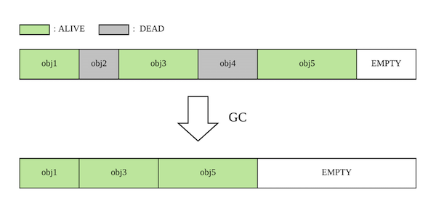
Strategies
Non-Moving / Non-Compacting Vs
Moving / Compacting
Notes:
Non-Moving
Could lead to fragmented heap
Harder to find space (-> a list vs compacting which just needs a single pointer)
Moving or Compacting
Additional work – update all references
Allocation is much easier/faster
Cannot use pointers

Slide 17
Strategies
Reference Counter
Increment / Decrement
with
Allocation / Deallocation
Usage:
Perl, PHP, Rust, Objective-C, …
File Systems
Distributed Systems
Notes:
File/Distributed Systems: too slow for Tracing GC
Automatic Reference Counting for C++

Slide 18
Strategies
Tracing
Objects not reachable from the root objects are garbage
Most common
Implementations:
Naïve Mark & Sweep
Tri-color marking
Generational GC
Notes:
Naïve Mark & Sweep
Halts the process. Traverses the entire graph twice.
Tri-color marking:
white -> gray -> black == the tri-color invariant
White: condemned
Gray: referenced but needs to be scanned (for references to whites)
Black: referenced
Can run on the fly without halting the process.
Generational GC:
Infant Mortality / Generational Hypothesis: most recently created objects are also most likely to become unreachable quickly
If the hypothesis does not hold true: the objects are promoted to the next generation
Heuristic approach: not everything viable for garbage collection is effectively cleaned up on the first sweep

Slide 19
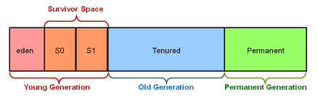
Java Object Generations
Notes:
Young Generation: minor GC
Old Generation: major GC
Evacuation:
Eden full: minor GC
Objects surviving this are moved to the first survivor space.
Eden full:
Object Aging: Objects surviving in Eden & Survivor space 1 are moved to survivor space2
Eden full:
Same but survival space 0 & 1 are switched
Promotion: objects aging x times are promoted to the old generation
Minor & Major GC are stop-the-world events. How long depends on the GC implementation used.
Permanent Generation: Contains JVM metadata (classes, methods, …)
Humongous Region: Added later with G1. Directly Tenured.
Evacuation failure: could cause an entire heap compacting

Slide 20
.NET & Java
Hybrid GC Implementations
Tracing
Generational
Compacting / Evacuation
Concurrent
Notes:
Java started with a quite simplistic GC (Serial) but quickly realized that it needed less STW-events
.NET started from the Java “lessons learned” and added some tricks that Java catched up on later on.
Hybrid:
Like sorting algorithms – no one size fits all
Generational:
Newer Java GC (GZC, Shenandoah) are NOT generational BUT they are working on it
Compacting / Non-Compacting:
The Java CMS does compacting on some generations and
The generations improve the Compacting time.
Concurrent:
Try to offload as much work as possible to reduce the amount of time in STW-events:
Multiple gc threads doing the work and synchronizing
GC threads work concurrently with the rest of the application

Slide 21
Java: Implementations
Serial: single threaded, stop-the-world
Parallel: serial running on multiple threads
Concurrent Mark & Sweep (CMS): default till Java 9
G1: default from Java 9
ZGC: default from Java 15
Shenandoah: single generation
C4 (Continuously Concurrent Compacting Collector)
Notes:
Serial:
Simple programs, client machines, mark & compact
Handles 100MB+ memory GC in a couple seconds
Also used on servers where many JVMs are running
Might make a comeback with embedded
Parallel:
The throughput Collector
Configuration for # threads (defaults to 1 per CPU), max pause time, max throughput target.
Works better than serial when CPUs > 2
UseCase: batch processing, long processes that may be halted for a long periods
CMS:
The Concurrent Low Pause Collector
Uses the Parallel GC for the young generations
Operates while the program threads are still running on the tenured generations – without compacting
Low pauses
UseCase: Desktop UI, Webserver Request Handling, Database Queries
G1: (4GB+ RAM)
Split into regions (max 2048) of equal size. Generational.
Garbage-first collector: after concurrent marking with Snapshot-At-The-Beginning (SATB) algorithm it collects regions with the least amount of live data first
Parallel & incrementally compacting evacuation
Concurrent marking : not scanning the entire heap in big stop-the-world event
Replacement of CMS : Meets soft real-time goals better than CMS
Introduces “Humongous Region” → When bigger than ½ of the region size AND StringDeduplication
Stages: Concurrent Initial Mark, Remark (reference updating), Cleanup
Out-of-memory: do a full compact
ZGC
Max 10ms. Heaps 8MB to 16TB.
Single Generation!
Regions can have different sizes.
STW events take 1-5ms instead of the +/-200ms of G1
Colored Pointers: use excess x64 space for adding extra info
(finalizable, remap, mark0, mark1)
Permanent space: concurrent class unloading
STW: Marking of root elements – time is not related to the size of the heap
Concurrent Marking
Concurrent Relocation → Achieved with Load-Barrier (person.name → update the ref when the obj is to be relocated)
Shenandoah
Multiple modes: generational is in the works
Open-Source
Brooks Pointers
Like ZGC: STW for root objects marking
Concurrent Marking
STW Final Mark (init evacuation, find live regions)
Concurrent Cleanup
Concurrent Evacuation (new)
STW: Init Update Refs (very short)
Concurrent Update Refs (new)
STW: Final Update Refs
Concurrent Cleanup
C4 (2005)
Azul’s Zing JVM. Pauseless GC Algorithm.
Generational but compacts concurrently.
No Stop-the-world.
Wants a large heap (64GB+)
Usage: Latency-sensitive apps

Slide 22
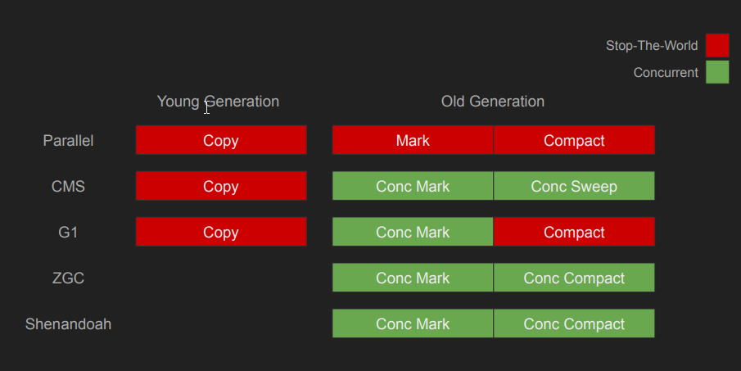
Java: Implementations
Notes:
The Shenandoah Mark & Compact is actually 9 steps., including (short) STW events.
The PDF also got interesting graphs explaining all those steps.
PDF:
https://assets.ctfassets.net/oxjq45e8ilak/709UsobBpBGHxaZ0z6MNvH/1d75677b26f1b7c9a71150c372645ad8/100746_367617808_Simone_Bordet_Concurrent_Garbage_collectors_ZGC__Shenandoah.pdf

Slide 23
.NET
Background GC
Managed Heap per Process
LOH: Large Object Heap (85KB+)
Modes: Workstation vs Server
Phases:
Marking
Relocating (update pointers)
Compacting
Notes:
VirtualAlloc & VirtualFree: Get/Release a block of memory from the OS
LOH: Sometimes called Generation 3. GC’d together with Generation 2. Is not compacted. → Introduced in Java with G1 “Humongous Region”
Generation 0 = Ephemeral Generation
Generation 2 objects can span multiple generations
A collection of generation 2 will also collect Gen0-1.
Survival: Promoted to the next generation after a GC
Modes:
Workstation: optimize for low-latency
Server: Optimized for throughput & resource utilization. Assumes it can use all CPU power.
Background GC: (replaces the old Concurrent GC, which can still be used for Generation2)
Generation0-1 -> Old GC
Generation2 -> New GC → Runs concurrently with the application on a dedicated thread
Multiple threads performing background GC
When a foreground GC occurs all managed threads are suspended. Foreground GC is on Ephemeral generations (0-1).
Root elements:
Stack roots
Managed Handles
Static Data
String:
Also in Java 8 : -XX:+UseStringDeduplication

Slide 24
Strong & Weak Refs
Java
import java.lang.ref.WeakReference;
import java.lang.ref.SoftReference;
WeakReference weakWidget = new WeakReference(widget);
weakWidget.get(); // could be null
C# var weakWidget = new WeakReference<Widget>(widget); weakWidget.Target;
Notes:
Java
WeakReference: will be GC’d
SoftReference: will resist GC unless there is memory pressure
.NET
No SoftReference equivalent
Methods: IsAlive, SetTarget, TryGetTarget, TrackResurrection
Long Weak References: Objects with Finalizer + use ctor overload with: boolean trackResurrection = false

Slide 25
Undeterministic & I/O
Finalization
Java try (FileReader br = new FileReader(path)) {
return br.readLine();
}
C# using var sr = new StreamReader(path);
return sr.ReadLine();
Notes:
Java
Must implement Closable or Autocloseable
.NET
Do not write a Finalizer yourself, use SafeHandle
Must implement IDisposable / IDisposableAsync
→ Prefer over Finalizer!!!
---
Finalizer:
Executed on separate thread. Not during GC because Finalizers could take a long time.
Might not be executed or be executed twice or be executed only partially
Might crash when using references that may already be collected
Deprecated in Java 9
Do not use directly in .NET – use a SafeHandle or inherit from CriticalFinalizerObject
Objects with finalizer are not GC’d directly but placed on the F-reachable queue (=root obj). All live objects with finalizer are placed on finalizer queue.
Supports out-of-this-world capabilities like resurrection – which you want to avoid at all costs

Slide 26
Java
PhantomReference
Ref to an object that may already be GC’d
No get() → ReferenceQueue class(es)
Replaces finalize()
No two GC sweeps needed
No resurrection
RefQueue monitoring possible
Finalization runtime opt-in
Notes:
Some info:
https://www.baeldung.com/java-phantom-reference
Resource:
https://tooslowexception.com/do-we-need-jvms-phantomreference-in-net/
Advantages:
Fine grained control over the release of resources
Avoid all the weird stuff going on with finalizers
Cleaner : Runnable:
→ Implementation of PhantomRef & RefQueue
Cleaner cleaner = Cleaner.create();
cleaner.register(object, runnable);
runnable.clean();
Example:
public class PhantomReferenceFinalizer extends PhantomReference<Object> {
// handle field - some resource to be released
public PhantomReferenceFinalizer(
Object referent, ReferenceQueue<? super Object> queue) {
super(referent, queue);
// get handle from referent
}
public void finalizeResources() {
// free handle
}
}
new PhantomReferenceFinalizer(someObject, referenceQueue);
while ((referenceFromQueue = referenceQueue.poll()) != null) {
((PhantomReferenceFinalizer)referenceFromQueue).finalizeResources();
}

Slide 27
WINNER!?
More or less on par
.NET started from lessons learned, Java catched up
Java has more advanced GC
Java allows more configuration
.NET does less allocations with structs & spans
Notes:
Lessons Learned & Java Catchup:
StringDeduplication was added to G1
Large Object Heap (Humongous) was added to G1
Java more advanced:
Escape Analysis
Evacuation
SoftReferences
Finalizer alternatives (Cleaner & PhantomReferences)
Implementations: Shenandoah & ZGC & C4

Slide 28
resources
Zdnet: 70% of security bugs are memory safety issues
Java Serial GC Tech Talk
The Stack is an Implementation Detail
Java GC’s Compared (with fancy drawings)
PluralSight: Intro to Garbage Collection

Slide 29
Questions?

Slide 30
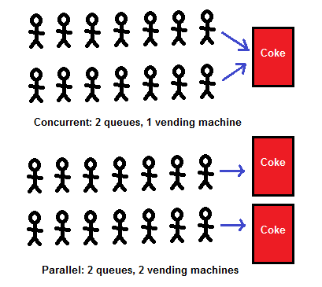
Concurrent vs Parallel

